Slide 1





NGS read alignment
Vivek Iyer
Human Genetics Informatics
Wellcome Sanger Institute
vvi@sanger.ac.uk
Including lots of material from Thomas Keane and Ant Doran
Notes:
Introduction and title

Slide 2
NGS read alignment
The most important first step in understanding next-generation sequencing data is the initial alignment or assembly that determines whether an experiment has succeeded and provides a first glimpse into the results.
Flicek & Birney, 2009. Nature Methods
Sequence alignment in NGS is:
Process of determining the most likely source of the observed DNA sequencing read within the reference genome sequence.
Principles and approaches to sequence alignment have not changed much since 80’s
Notes:
Let’s open with an expansive quote from two ABSOLUTE GIANTS in the field.
Just for reference, this is what Sequence alignment is. It’s the process of determining the most likely source of the observed DNA Seq read …
NOTE that I’m already speaking a bias in the way I view the work, in that I’m tethered to A reference,
AND you don’t have to have the bias
But you DO have to listen to the talk.
Principles approaches haven’t changed.
Actually that’s bollocks: the methods (approaches) have changed a lot

Slide 3
Overview
Intro - REFERENCES
Methods / Aligners
NGS Workflows, QC and BAM Improvement
Notes:
The talk is long, but we’ll take breaks.
Long because it touches on a few quite distinct bits that all stitch together:
How it’s done,
How to watch the outputs (raw alignments or from a viewer)
How NGS data is prepared before analysis: alignment is only one step.

Slide 4
The reference is key in all that follows
Sequence alignment in NGS is:
Process of determining the most likely source of
the observed DNA sequencing read
within
the reference genome sequence
Notes:
FOR ME, this is alignment:
The reference is key.
We are deeply biased here, in that we always operate in the context of a reference.

Slide 5
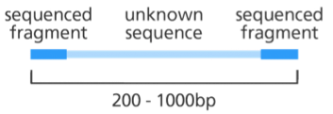
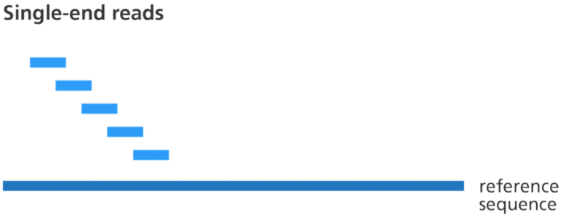
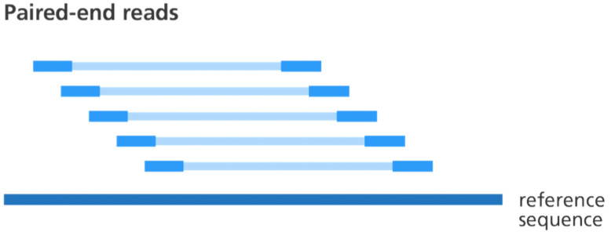
The reference is key in all that follows
Image credit: Genome Research Limited
The view of alignment in this lecture is wildly asymmetric:
short read sequences
very long reference sequences. Genomes (~Gbp) or Transcriptomes (~100Mbp)
Where do references come from?
Organism => Consortium => Money => Sequencing => Assembly => Curation=> Dissemination => Curation, Dissemination => …
Human, Mouse, Zebrafish, Chicken:
Lots of curation / dissemination was done at various centres and distributed by NCBI. NCBI still distributes!
Now the umbrella for curation / patching is: Genome Reference Consortium
Notes:
That was just words, but this is the picture in my head. Little blue boxes are (relatively short) sequence reads – could be 75bp or 150bp or a few hundred – to kilobases
The big blue line is a REFERENCE: most of the time will be aligning to a genome (sometimes not). Where does the reference come from? Depends on the organism.
Individual centres do the sequencing (grant funding) and assembly. Creation of a reference involves sequencing and assembly.
In the past NCBI did a lot of assembly / curation / distribution for human, mouse:
Overall coordination now passed to the GRC!! What’s the GRC? It’s a shell company for genome annotation curators at different institutes: BROAD, SANGER, NIH, NHGRI, etc

Slide 6
The reference is key in all that follows
Image credit: Genome Research Limited
The view of alignment in this lecture is wildly asymmetric:
short read sequences
very long reference sequences. Genomes (~Gbp) or Transcriptomes (~100Mbp)
Where do references come from?
Organism => Consortium => Money => Sequencing => Assembly => Curation=> Dissemination => Curation, Dissemination => …
Human, Mouse, Zebrafish, Chicken:
Lots of curation / dissemination was done at various centres and distributed by NCBI. NCBI still distributes!
Now the umbrella for curation / patching is: Genome Reference Consortium
TREE OF LIFE PROGRAM AT SANGER – now 3 years old - IS CHANGING THIS FOREVER
Notes:
That was just words, but this is the picture in my head. Little blue boxes are (relatively short) sequence reads – could be 75bp or 150bp or a few hundred – to kilobases
The big blue line is a REFERENCE: most of the time will be aligning to a genome (sometimes not). Where does the reference come from? Depends on the organism.
Individual centres do the sequencing (grant funding) and assembly. Creation of a reference involves sequencing and assembly.
In the past NCBI did a lot of assembly / curation / distribution for human, mouse:
Overall coordination now passed to the GRC!! What’s the GRC? It’s a shell company for genome annotation curators at different institutes: BROAD, SANGER, NIH, NHGRI, etc

Slide 7
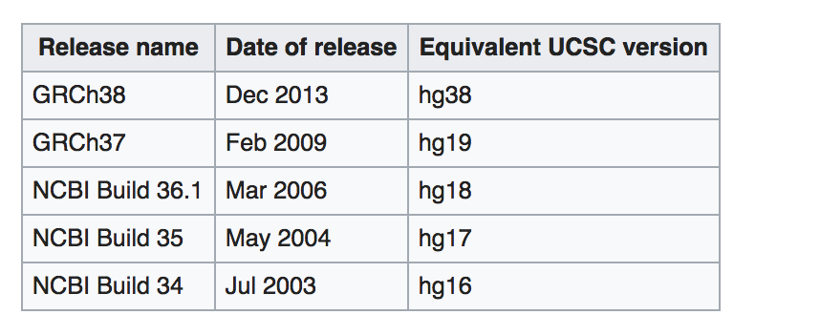
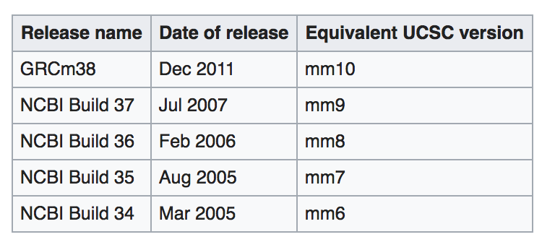
The reference is key in all that follows
Image credit: Genome Research Limited
HUMAN reference sequences
MOUSE reference sequences
The actual reference is a just a (big) sequence (fasta) file: $ ls –h GRCh38.fa
> 3.1G GRCh38.fa
Notes:
What does this consortium EMIT?
Versioned assemblies.
I’ve listed the names and dates of human assemblies. You can see that although the current one (h38) was emitted 7 years ago, …
For mouse, the situation is a lot easier and saner.
What is an assembly? It’s basically a big fasta file (you were dealing with fasta this morning)

Slide 8
The reference is key in all that follows
Image credit: Genome Research Limited
Patches (up to last year) – no coord change to h38
GRCm39 July 2020 – will take a while to adjust
HUMAN reference sequences
MOUSE reference sequences
The actual reference is a just a (big) sequence (fasta) file: $ ls –h GRCh38.fa
> 3.1G GRCh38.fa
Notes:
What does this consortium EMIT?
Versioned assemblies.
I’ve listed the names and dates of human assemblies. You can see that although the current one (h38) was emitted 7 years ago, …
For mouse, the situation is a lot easier and saner.
What is an assembly? It’s basically a big fasta file (you were dealing with fasta this morning)

Slide 9
The reference is key in all that follows
How many sequences in GRCh38.fa ?
24 ?
HUMAN reference sequences
The actual reference is a just a (big) sequence (fasta) file: $ ls –h GRCh38.fa
> 3.1G GRCh38.fa

Slide 10
The reference is key in all that follows
How many sequences in GRCh38.fa ?
24 ?
NO : 3336 !
22 autosomes + X + Y and …
M – mitochondrion and …
“_alt” sequences: large regions of chromosomes very similar, but sufficiently different to be given their own separate sequence
“_decoy” sequences: 36Mb of stuff not in the assembly
_HLA sequences: alternate HLA haplotypes
HUMAN reference sequences
The actual reference is a just a (big) sequence (fasta) file: $ ls –h GRCh38.fa
> 3.1G GRCh38.fa

Slide 11
The reference is key in all that follows
How many sequences in GRCh38.fa ?
24 ?
NO : 3336 !
22 autosomes + X + Y and …
M – mitochondrion and …
“_alt” sequences: large regions of chromosomes very similar, but sufficiently different to be given their own separate sequence
“_decoy” sequences: 36Mb of stuff not in the assembly
_HLA sequences: alternate HLA haplotypes
HUMAN reference sequences
The actual reference is a just a (big) sequence (fasta) file: $ ls –h GRCh38.fa
> 3.1G GRCh38.fa

Slide 12
Why align short reads?
Notes:
ONCE YOU HAVE A REFERENCE,
THEN you can align read to it.
AND THESE are typical inferences you can make with alignment:
Variation from the reference – could have functional consequence.
Transcript abundance: Very common to use alignment to genome to quantify transcript expression.

Slide 13
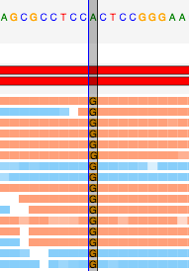
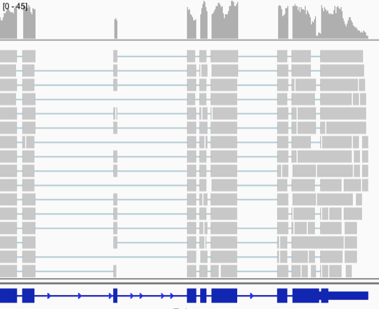
Why align short reads?
Image credit: Genome Research Limited
Align DNA: Identify variation
ALIGN RNA: Transcript abundance
Notes:
ONCE YOU HAVE A REFERENCE,
THEN you can align read to it.
AND THESE are typical inferences you can make with alignment:
Variation from the reference – could have functional consequence.
Transcript abundance: Very common to use alignment to genome to quantify transcript expression.

Slide 14
Overview
Intro
Methods / Aligners
NGS Workflows, QC and BAM Improvement

Slide 15
Overview
Intro
Methods / Aligners
And limitations
And scaling up
NGS Workflows, QC and BAM Improvement

Slide 16
Local alignment: Smith-Waterman algorithm (1981)
Algorithm for generating the optimal pairwise alignment between two sequences
Optimal alignment: the alignment which exhibits the most correspondences and the least differences, i.e. the alignment with the highest mapping score
Time consuming to carry out for every read - impractical
Aligner will use it to refine a quick approximate placement
Variant caller might use it to correctly re-align reads with insertions/deletions
Notes:
I will SKETCH three alignment methods now.
The first SMITH-WATERMAN is the easiest to demonstrate, because we can all watch it go.
It is an algorithm for generating the optimal pairwise alignment between two sequences.
And by OPTIMAL we mean the alignment which optimises a score, which reflects the most correspondences and the least differences.
It’s easy to demonstrate, BUT it’s very slow to carry out for every read, so in practice, these days,
it’s only carried out for a subset of reads, when the aligner at the end is trying to finesse its results.

Slide 17
Alignment methods
Smith Waterman (good conceptually , but slow)
Hash-based methods
Suffix tree-based / BW-transform based methods
Notes:
I will SKETCH three alignment methods now.
The first SMITH-WATERMAN is the easiest to demonstrate, because we can all watch it go.
It is an algorithm for generating the optimal pairwise alignment between two sequences.
And by OPTIMAL we mean the alignment which optimises a score, which reflects the most correspondences and the least differences.
It’s easy to demonstrate, BUT it’s very slow to carry out for every read, so in practice, these days,
it’s only carried out for a subset of reads, when the aligner at the end is trying to finesse its results.

Slide 18
Local alignment: Smith-Waterman algorithm (1981)
Algorithm for generating the optimal pairwise alignment between two sequences
Optimal alignment: the alignment which exhibits the most correspondences and the least differences, i.e. the alignment with the highest mapping score
S1
 |  | A | C | T | G
 | 0 | 0 | 0 | 0 | 0
A | 0
C | 0
G | 0
Step 1: write out the two sequences as margins in a table
S2
Notes:
I’ve explained this and we’ve run this in past lectures, and the results were mixed – some confusion, some success.
We’re not going to do one here
What’s the takeaway:
You write out the little seq on one side, the big seq on the other
You score every cell in the matrix with a predetermined number, depending on whether it’s a match or mismatch, and whether you entered the cell from left, right or diag
You end with highest score, and trace back, and decide based on the entry direction whether you’re matching / mismatching or gapping.
THE POINT: it’s a fixed, deterministic algorithm which WILL give you the optimal alignment. Not based on heuristics.
THE PROBLEM: it’s too slow for genome-sized targets
=========
Explanation 3
The alignment is a path on the grid, achieved by
1) Assigning a score to every cell in the table: score = max of three numbers, each of which depend on (a) score in adjacent cell and (b) direction of entry into this cell
2) Keep a track of direction of entry
3) When you’re done, find max score on the grid, and traceback, writing two sequences next to each other, with a match/mismatch for those cells entered diagonally , and a gap for sideways or vertical entries
The result is the alignment!
======
Explanation 2
if you're trying to align 3 vs 4
write out a grid
alignment is a PATH on that grid
how do youc choose the path?
score every cell depednetn on whether the possible path enters the cell from the top, side or diag:
top -insertion penalty
side - deletion pen
diag: IF match - positive score, if a mismatch - penalty. Every box has three possible scores dependnig on WHICH direction you came in from. One of these is the BEST entry score / Entry direction
If you work from L=>R , T=>B , remembering WHICH entry gave you the best score for the box, then you're left with a box with the biggest score in the matrix
Then you BACKTRACE To find the actual alignment
The path IS the alignment: a diag means match/mismatch , a vertical means ins or deletion
THE POINT: it’s a fixed, deterministic algorithm which WILL give you the optimal alignment. Not based on heuristics.
THE PROBLEM: it’s too slow for genome-sized targets

Slide 19
Local alignment: Smith-Waterman algorithm (1981)
Algorithm for generating the optimal pairwise alignment between two sequences
Optimal alignment: the alignment which exhibits the most correspondences and the least differences, i.e. the alignment with the highest mapping score
S1
 |  | A | C | T | G
 | 0 | 0 | 0 | 0 | 0
A | 0 | -1, -1 1 = 1 | -1, 0 -1 = 0 | -1, -1 -1= 0 | -1 -1 -1=0
C | 0 | 0 -1 0=0 | -1 -1 2=2 | -1 1,-1= 1 | -1 0, -1= 0
G | 0 | -1 -1 -1= 0 | 1 -1 -1=1 | 0 0 1 = 1 | -1 0 2 = 2
Step 2: Assign each cell a score, based on value of score in adjacent cell and whether you entered from top, bottom or diagonally
Score = maximum of three possible
Remember direction which yielded that!
Find GLOBAL BEST SCORE in table
Red arrow = Traceback from global best score
S2
Notes:
I’ve explained this and we’ve run this in past lectures, and the results were mixed – some confusion, some success.
We’re not going to do one here
What’s the takeaway:
You write out the little seq on one side, the big seq on the other
You score every cell in the matrix with a predetermined number, depending on whether it’s a match or mismatch, and whether you entered the cell from left, right or diag
You end with highest score, and trace back, and decide based on the entry direction whether you’re matching / mismatching or gapping.
THE POINT: it’s a fixed, deterministic algorithm which WILL give you the optimal alignment. Not based on heuristics.
THE PROBLEM: it’s too slow for genome-sized targets
=========
Explanation 3
The alignment is a path on the grid, achieved by
1) Assigning a score to every cell in the table: score = max of three numbers, each of which depend on (a) score in adjacent cell and (b) direction of entry into this cell
2) Keep a track of direction of entry
3) When you’re done, find max score on the grid, and traceback, writing two sequences next to each other, with a match/mismatch for those cells entered diagonally , and a gap for sideways or vertical entries
The result is the alignment!
======
Explanation 2
if you're trying to align 3 vs 4
write out a grid
alignment is a PATH on that grid
how do youc choose the path?
score every cell depednetn on whether the possible path enters the cell from the top, side or diag:
top -insertion penalty
side - deletion pen
diag: IF match - positive score, if a mismatch - penalty. Every box has three possible scores dependnig on WHICH direction you came in from. One of these is the BEST entry score / Entry direction
If you work from L=>R , T=>B , remembering WHICH entry gave you the best score for the box, then you're left with a box with the biggest score in the matrix
Then you BACKTRACE To find the actual alignment
The path IS the alignment: a diag means match/mismatch , a vertical means ins or deletion
THE POINT: it’s a fixed, deterministic algorithm which WILL give you the optimal alignment. Not based on heuristics.
THE PROBLEM: it’s too slow for genome-sized targets

Slide 20
Local alignment: Smith-Waterman algorithm (1981)
Algorithm for generating the optimal pairwise alignment between two sequences
Optimal alignment: the alignment which exhibits the most correspondences and the least differences, i.e. the alignment with the highest mapping score
S1
 |  | A | C | T | G
 | 0 | 0 | 0 | 0 | 0
A | 0 | -1, -1 1 = 1 | -1, 0 -1 =0 | -1, -1 -1=0 | -1 -1 -1=0
C | 0 | 0 -1 0=0 | -1 -1 2=2 | -1 1,-1= 1 | -1 0, -1= 0
G | 0 | -1 -1 -1= 0 | 1 -1 -1=1 | 0 0 1 = 1 | -1 0 2 = 2
S2
WRITE OUT ALIGNMENT:
S1 A C T G
S2 A C - G
Notes:
I’ve explained this and we’ve run this in past lectures, and the results were mixed – some confusion, some success.
We’re not going to do one here
What’s the takeaway:
You write out the little seq on one side, the big seq on the other
You score every cell in the matrix with a predetermined number, depending on whether it’s a match or mismatch, and whether you entered the cell from left, right or diag
You end with highest score, and trace back, and decide based on the entry direction whether you’re matching / mismatching or gapping.
THE POINT: it’s a fixed, deterministic algorithm which WILL give you the optimal alignment. Not based on heuristics.
THE PROBLEM: it’s too slow for genome-sized targets
=========
Explanation 3
The alignment is a path on the grid, achieved by
1) Assigning a score to every cell in the table: score = max of three numbers, each of which depend on (a) score in adjacent cell and (b) direction of entry into this cell
2) Keep a track of direction of entry
3) When you’re done, find max score on the grid, and traceback, writing two sequences next to each other, with a match/mismatch for those cells entered diagonally , and a gap for sideways or vertical entries
The result is the alignment!
======
Explanation 2
if you're trying to align 3 vs 4
write out a grid
alignment is a PATH on that grid
how do youc choose the path?
score every cell depednetn on whether the possible path enters the cell from the top, side or diag:
top -insertion penalty
side - deletion pen
diag: IF match - positive score, if a mismatch - penalty. Every box has three possible scores dependnig on WHICH direction you came in from. One of these is the BEST entry score / Entry direction
If you work from L=>R , T=>B , remembering WHICH entry gave you the best score for the box, then you're left with a box with the biggest score in the matrix
Then you BACKTRACE To find the actual alignment
The path IS the alignment: a diag means match/mismatch , a vertical means ins or deletion
THE POINT: it’s a fixed, deterministic algorithm which WILL give you the optimal alignment. Not based on heuristics.
THE PROBLEM: it’s too slow for genome-sized targets

Slide 21
Local alignment: Smith-Waterman algorithm (1981)
Algorithm for generating the optimal pairwise alignment between two sequences
Optimal alignment: the alignment which exhibits the most correspondences and the least differences, i.e. the alignment with the highest mapping score
Time consuming to carry out for every read - impractical
Aligner will use it to refine a quick approximate placement
Variant caller might use it to correctly re-align reads with insertions/deletions
S1
 |  | A | C | T | G
 | 0 | 0 | 0 | 0 | 0
A | 0 | -1, -1 1 = 1 | -1, 0 -1 =0 | -1, -1 -1=0 | -1 -1 -1=0
C | 0 | 0 -1 0=0 | -1 -1 2=2 | -1 1,-1= 1 | -1 0, -1= 0
G | 0 | -1 -1 -1= 0 | 1 -1 -1=1 | 0 0 1 = 1 | -1 0 2 = 2
S2
WRITE OUT ALIGNMENT:
S1 A C T G
S2 A C - G
Notes:
I’ve explained this and we’ve run this in past lectures, and the results were mixed – some confusion, some success.
We’re not going to do one here
What’s the takeaway:
You write out the little seq on one side, the big seq on the other
You score every cell in the matrix with a predetermined number, depending on whether it’s a match or mismatch, and whether you entered the cell from left, right or diag
You end with highest score, and trace back, and decide based on the entry direction whether you’re matching / mismatching or gapping.
THE POINT: it’s a fixed, deterministic algorithm which WILL give you the optimal alignment. Not based on heuristics.
THE PROBLEM: it’s too slow for genome-sized targets
=========
Explanation 3
The alignment is a path on the grid, achieved by
1) Assigning a score to every cell in the table: score = max of three numbers, each of which depend on (a) score in adjacent cell and (b) direction of entry into this cell
2) Keep a track of direction of entry
3) When you’re done, find max score on the grid, and traceback, writing two sequences next to each other, with a match/mismatch for those cells entered diagonally , and a gap for sideways or vertical entries
The result is the alignment!
======
Explanation 2
if you're trying to align 3 vs 4
write out a grid
alignment is a PATH on that grid
how do youc choose the path?
score every cell depednetn on whether the possible path enters the cell from the top, side or diag:
top -insertion penalty
side - deletion pen
diag: IF match - positive score, if a mismatch - penalty. Every box has three possible scores dependnig on WHICH direction you came in from. One of these is the BEST entry score / Entry direction
If you work from L=>R , T=>B , remembering WHICH entry gave you the best score for the box, then you're left with a box with the biggest score in the matrix
Then you BACKTRACE To find the actual alignment
The path IS the alignment: a diag means match/mismatch , a vertical means ins or deletion
THE POINT: it’s a fixed, deterministic algorithm which WILL give you the optimal alignment. Not based on heuristics.
THE PROBLEM: it’s too slow for genome-sized targets

Slide 22
NGS read alignment
NGS: Nucleotide based alignment (also known as read mapping)
Number of 150bp reads in an 40x coverage Illumina NovaseqX genome sequence?
800x10^6
These all have to be aligned against a mammalian genome (3Gbp)
SMITH-WATERMAN is WAY TOO SLOW:
Two primary faster approaches:
Hash-based alignment
Suffix/prefix tries
Notes:
TO EMPHASISE THIS:
there are about a billion reads in a typical WGS output
The target is 3Gbp long
This method is too slow
This method is way too slow for processing realistic nmbers of NGS reads.
We will now sketch a couple of methods that speed things up.

Slide 23
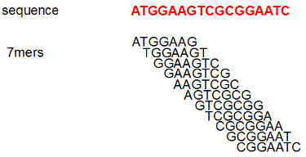
Hash table alignment
Note: K-mer is a short fixed sequence of nucleotides
First thing: “wrap up” the reference genome to bring it to the reads – build a kmer hash
Scan the reference genome:
Build a profile (index) of all possible k-mers of length n
and the locations in the reference genome they occur:
Hash table will be several Gbytes in size for human genome
Notes:
The first fast method is a hash-table.
It’s worth seeing how this goes, because it’s pretty intutive
To WRAP up this enormous genome, and bring it close to the reads:
A typical algorithm will SCAN the REFERNCE GENOME base by base,
And record the kmer of length n starting at that base (e.g. 7mers)
It will PUT that kmer into a dictionary, along with a reference of where that kmer was found.
This is an example of the kmer-recording for 7-mers in this “genome”
Typical kmer hash for a mammalian genome is several Gb
THEN for each query sequence read, the algorithm will find the kmers in the read, look up the hash to work out where those kmers are in the gnome, and get an approximate best location of the read.
THEN it will do a careful Smith-waterman of the read in that approximate region to get the full alignment.
It turns out you can hash the genome and do the lookup with the reads (very large mem, but constant cost), or the other way around (lower mem, but variable cost)

Slide 24

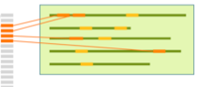

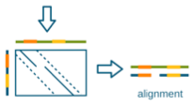
Hash table alignment
Start with the reference genome
Sequencing reads
Reference Genome
Notes:
Here is another way of saying the same thing:
On the right is the reference genome.
You scan through it building up a kmer-hash
The hash you build has an entry for every distinct kmer, AND points back at the locations the kmer was found
AND IT CAN BE HUGE IN SIZE
Key point: it’s a way of packaging up the reference genome and bringing the information to the query sequences

Slide 25
Hash table alignment
Start with the reference genome
Sequencing reads
Reference Genome
Kmer hash
Build a data structure (hash)
allows rapid lookup by kmer sequence.
Each kmer entry in the hash stores the genome location(s) the kmer came from.
Notes:
Here is another way of saying the same thing:
On the right is the reference genome.
You scan through it building up a kmer-hash
The hash you build has an entry for every distinct kmer, AND points back at the locations the kmer was found
AND IT CAN BE HUGE IN SIZE
Key point: it’s a way of packaging up the reference genome and bringing the information to the query sequences

Slide 26
Hash table alignment
Sequencing reads
Kmer hash
Reference Genome
read
read
Notes:
Similarily, we can find those kmers in the reads

Slide 27
Hash table alignment
Sequencing reads
Kmer hash
Reference Genome
read
read
Notes:
And by using the KEPT locations in the kmer hash, we can BEGIN to map these reads to locations on the genome:
For instance, two kmers from a read will be found in a kmer hash,
and those two entries in the hash will be found in many places in the genome.
BUT two of those places may be close together, and so those alignments will be preferred,
and the read as a whole will be preferably aligned in that area
Of the many possibilities, find a best approximation
We can then carefully align the original read and the best approximation (the “extend” bit) using SW to get an optimal alignment

Slide 28
Hash table alignment
Sequencing reads
Kmer hash
Reference Genome
read
read
Notes:
We can then carefully align the original read and the best approximation (the “extend” bit) using SW to get an optimal alignment

Slide 29
Hash table alignment
Note: K-mer is a short fixed sequence of nucleotides
First thing: “wrap up” the reference genome to bring it to the reads – build a kmer hash
Scan the reference genome:
Build a profile (index) of all possible k-mers of length n
and the locations in the reference genome they occur:
Hash table will be several Gbytes in size for human genome
Next: For each sequence read:
Split the read into k-mers of length n
Lookup the locations in the reference via the index (seed phase)
Pick region on the genome with most k-mer hits
Perform Smith-Waterman alignment to fully align the read to the region
Output the alignment of each read onto the reference in BAM (or equivalent) format.
Notes:
The first fast method is a hash-table. This is a sketch of how it works.
A typical algorithm will SCAN the REFERNCE GENOME base by base,
And record the kmer of length n starting at that base (e.g. 7mers)
It will PUT that kmer into a dictionary, along with a reference of where that kmer was found.
This is an example of the kmer-recording for 7-mers in this “genome”
Typical kmer hash for a mammalian genome is several Gb
THEN for each query sequence read, the algorithm will find the kmers in the read, look up the hash to work out where those kmers are in the gnome, and get an approximate best location of the read.
THEN it will do a careful Smith-waterman of the read in that approximate region to get the full alignment.
It turns out you can hash the genome and do the lookup with the reads (very large mem, but constant cost), or the other way around (lower mem, but variable cost)

Slide 30
Wrapping up the genome and bringing it to your reads
wrap up
GENOME
Kmer-hash
Rapid lookup
Reads
Notes:
So we have seen one method of summarising the genome and bringing it to the reads, and seen how it facilitates rapid lookup / alignment, at the cost of lots fo extra data structures.
The second main aligner method is the suffix tree method: it is another way of summarising the genome so that you can do rapid lookups for reads (followed by careful local alignments)

Slide 31
Wrapping up the genome and bringing it to your reads
wrap up
GENOME
Kmer-hash
Rapid lookup
Reads
Suffix trie
…Suffix tree
…FM index
Rapid lookup
Notes:
So we have seen one method of summarising the genome and bringing it to the reads, and seen how it facilitates rapid lookup / alignment, at the cost of lots fo extra data structures.
The second main aligner method is the suffix tree method: it is another way of summarising the genome so that you can do rapid lookups for reads (followed by careful local alignments)

Slide 32
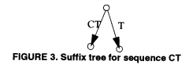
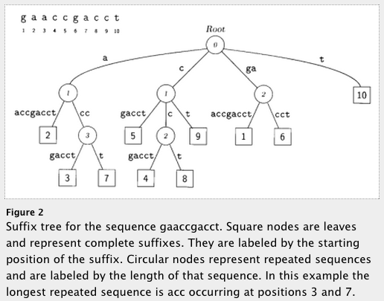
Suffix/Prefix tree based aligners
For fast string matching: A suffix trie, or simply a trie, is a data structure that stores all the suffixes of a string, enabling fast string matching.
Build a suffix-trie for the genome:
- a different structure to bring the genome to the query
- But the memory requirements are huge
More terms: BW transform, FM-index …
- Methods of reducing memory & time footprint
Examples: BWA, bowtie2
Genome
Trie based on genome
(slightly compacted)
Delcher et al (1999) NAR
Notes:
Suffix trie (pronounced “try”) is a data structure which allows the whole genome to be indexed: this is a different way of bringing the wrapped-up genome to your query sequences.
Here are a couple of examples of suffix tries – the first one is for a sequence of two characters, the first last letter (T) and then the next suffice CT, and build a second branch.
Similarly, if your whole genome consisted of “GAACCG…T” then you’d first build a path from the last letter (T), and then CT, the CCT etc. The number in the square is the start position of the suffix.
The resulting structure is a compact way of storing a wrapped up genome, along with locations where the subsequences were drawn from.
SO you can walk up to this structure with a read (a short pattern), and chase down the paths that match your pattern, and read off the matching substrings and their positions, since the tree LEAVES store the ending positions of the suffixes. SO you recover where there was a match + position of the match. This can be shown to be QUICKER than other methods.
The storage cost of the tree is enormous, so the GENOME is first subject to a BW transform / FM index to make it compact:
THEN the trie is built.
And the transition from the original trie to the BW-transformed suffix array is beyond the scope of this talk.
EXAMPLES of aligners which use suffix trees and BW indices include the big two (BWA and BOWTIE2)

Slide 33
Aligners – in summary
Smith – Waterman:
deterministic but too slow
Hash / Kmer – based
Suffix Trie / BW Transform + FM-indices
Compact genome representation allowing …
Rapid heuristic seed step with a SW extension
Notes:
Suffix trie (pronounced “try”) is a data structure which allows the whole genome to be indexed: this is a different way of bringing the wrapped-up genome to your query sequences.
Here are a couple of examples of suffix tries – the first one is for a sequence of two characters, the first last letter (T) and then the next suffice CT, and build a second branch.
Similarly, if your whole genome consisted of “GAACCG…T” then you’d first build a path from the last letter (T), and then CT, the CCT etc. The number in the square is the start position of the suffix.
The resulting structure is a compact way of storing a wrapped up genome, along with locations where the subsequences were drawn from.
SO you can walk up to this structure with a read (a short pattern), and chase down the paths that match your pattern, and read off the matching substrings and their positions, since the tree LEAVES store the ending positions of the suffixes. SO you recover where there was a match + position of the match. This can be shown to be QUICKER than other methods.
The storage cost of the tree is enormous, so the GENOME is first subject to a BW transform / FM index to make it compact:
THEN the trie is built.
And the transition from the original trie to the BW-transformed suffix array is beyond the scope of this talk.
EXAMPLES of aligners which use suffix trees and BW indices include the big two (BWA and BOWTIE2)

Slide 34
Overview
Intro
Methods / Aligners
And limitations
And scaling up
NGS Workflows, QC and BAM Improvement

Slide 35
Short-read Alignment Limitations
PROBLEMS WITH THE GENOME
Read Length and complexity of the genome
Very short reads difficult to align confidently to the genome
Low complexity genomes present difficulties
Malaria is 80% AT - lots of low complexity AT stretches
Alignment around indels
Next-gen alignments tend to accumulate false SNPs near true indel positions due to misalignment
Smith-Waterman scoring schemes generally prefer a SNP rather than a gap open
Tools developed to do a second pass on a BAM and locally realign the reads around indels and ‘correct’ the read alignments
High density SNP regions
Seed and extend based aligners can have an upper limit on the number of consecutive SNPs in seed region of read (e.g. Maq - max of 2 mismatches in first 28bp of read, bowtie has a max mismatch arg)
BWT based aligners work best at low divergence
Notes:
Good to know when aligners can run into problems
Two classes of problems
Genome itself: points on this slide
Issues with the read – points on next slide

Slide 36
Mapping qualities
PROBLEMS WITH THE READ
What if there are several possible places in the genome to align your sequencing read?
Genomes contain many different types of repeated sequences
Transposable elements (40-50% of vertebrate genomes)
Low complexity sequence
Reference errors and gaps
Plenty of closely paralogous genes!
In response: The aligner will issue a MAPPING QUALITY to each read alignment
Mapping quality is a measure of how confident the aligner is that the read actually maps to this location in the reference genome
Typically represented as a phred score (log scale) – probability that the read maps elsewhere
Q0 = read placed with identical score elsewhere
Q10 = 1 in 10 probability of being incorrect
Q20 = 1 in 100 probability of being incorrect
Paired-end sequencing is useful - if one end maps inside a repetitive elements and one outside in unique sequence: the the aligner will use this
Hence prefer paired-end sequencing
Notes:
EVEN in the ABSENCE of problematic genomes:
Here are more problems aligners have to deal with:
TE
LCS
REF errors
Gene Paralogues
The response of the alginger is to issue a MQ to each alignment, and reduce the quality when it’s unsure
So for instance …
BUT the aligner will use tricks: if you have redundancy in the information: eg you are using PE reads and one of the pair places well, and the other one places everywhere, THEN the aligner will guide the poor alginmetn with the good alignment
Also worth pointing out: PE is better for alignment

Slide 37
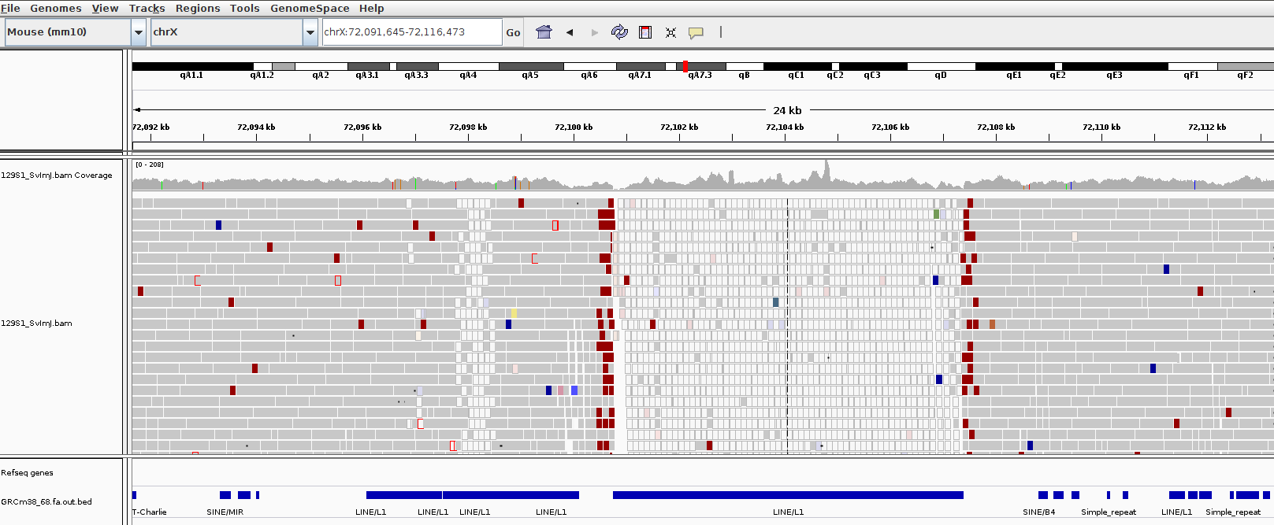
Mapping qualities
Notes:
Here’s an example of a region where the MAPQ of the reads abruptly goes to zero over a LINE1 element

Slide 38
Mapping qualities
MapQ: 0
MapQ: 60
Notes:
Here’s an example of a region where the MAPQ of the reads abruptly goes to zero over a LINE1 element

Slide 39
Some alignment options – near future
Aligner | Gapped alignment | SE and/or PE | Input format | Output format | Trimming? | BS-seq | Note
Minimap2 | Yes | SE, PE | FASTQ, FASTA | SAM etc | No | No | Long-read, and short-read, spliced
DRAGMAP | Yes | SE, PE | FASTQ, BAM, CRAM | CRAM, BAM | No | Yes | Hashtable lookup and extend
BWAMEM2 | Yes | SE, PE | FASTQ FASTA | SAM | No | No | BWT + extend: Local alignment
Bowtie2 | Yes | SE, PE | FASTQ FASTA qseq | SAM | Yes | No | BWT + extend: Local alignment
TopHat | Yes | SE, PE | FASTQ FASTA qseq | SAM | Yes | No | Uses bowtie or bowtie2 as base aligner
STAR | Yes | SE, PE | FASTQ FASTA | SAM | Yes | No | Fastest and most accurate for RNAseq
Assembly
TreeofLife
careful
Unspliced:
No intron-sized gaps
Spliced aligns
(RNASeq)
Spliced:
Allow for big gaps inside reads, are aware of gene-structure
Independently performs spliced aligns (no preprocessing)
Notes:
Here I’ve written two current aligners and two splice-aware aligners.
Moral – this table actually looks remarkably uniform, once you account for specific function:
It’s possible that your team / institute etc will make choices based on FUNCTION. Do you need spliced alignment?

Slide 40
Overview
Intro
Methods / Aligners
And limitations
And scaling up
NGS Workflows, QC and BAM Improvement

Slide 41
Alignments – scaling up
Question:
IF: 50Mbp bwa mem = 5 CPU minutes.
AND: 1 human genome sequenced at 45x = 150 Gbp per HiSeqX10 lane
THEN: How long will it take to align your 45x human genome sequencing?
Notes:
So let’s move onto the practicalities of actually aligning genomes at scale
Here’s a question …

Slide 42
Alignments – scaling up
Question:
IF: 50Mbp bwa mem = 5 CPU minutes.
AND: 1 human genome sequenced at 45x = 150 Gbp per HiSeqX10 lane
THEN: How long will it take to align your 45x human genome sequencing?
ANSWER:
How many lots of 50Mb in 150Gb ?
150Gb / 50Mb = (150 x 10^9) / (50 x 10^6) = 3 x 10^3 lots
Each lot takes 5 minutes => total time is 5 x 3 x 10^3 CPU minutes
15000 CPU minutes = 250 hours ~ 10 days ouch.

Slide 43
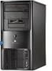
Alignments – scaling up
This is why we like compute clusters!
AS ALWAYS: The strategy is to:
Chop up the problem into small pieces and
Solve each piece in parallel, with N computers working at same time
Put the pieces back together after.
RESULT: Time of problem is reduced by N.
@read1
ACGTANATCN
+
$$%SSG$%££@
@read2
AGCNTNCTCA
+
£$$%£$%%^&
Full file.fastq
Piece2.fastq
…
PieceN.fastq
Piece1.fastq
N Computers
Piece1.bam
…
PieceN.bam
Full File. BAM
Notes:
You know that the most common sequence format prior to alignment is FASTQ.
So, naively, if we had 150Gbp of fastq, we could throw it at a single computer and wait for 10 days.
Instead, we ALWAYS do the following:
Chop the problem into small pieces by chopping up the fastq
Align each piece on a separate computer
Stitch the pieces together afterwards.
OR OR OR exploit the fact that modern computers have multiple cores: but your software has to be able to exploit multiple cores (eg bwa-mem –t …)

Slide 44
Alignments – scaling up
This is why we like compute clusters!
AS ALWAYS: The strategy is to:
Chop up the problem into small pieces and
Solve each piece in parallel, with N computers working at same time
Put the pieces back together after.
RESULT: Time of problem is reduced by N.
@read1
ACGTANATCN
+
$$%SSG$%££@
@read2
AGCNTNCTCA
+
£$$%£$%%^&
Full file.fastq
Piece2.fastq
…
PieceN.fastq
Piece1.fastq
OR OR Utilise multiple processors on single computer
Modern computers have >1 processing core or CPU
Most aligners can use more than one processor on same computer
Much easier for user
Just supply the number of processors to use (e.g. bwa-mem -t option)
N Computers
Piece1.bam
…
PieceN.bam
@read1
ACGTANATCN
+
$$%SSG$%££@
@read2
AGCNTNCTCA
+
£$$%£$%%^&
BAM
Full File. BAM
Notes:
You know that the most common sequence format prior to alignment is FASTQ.
So, naively, if we had 150Gbp of fastq, we could throw it at a single computer and wait for 10 days.
Instead, we ALWAYS do the following:
Chop the problem into small pieces by chopping up the fastq
Align each piece on a separate computer
Stitch the pieces together afterwards.
OR OR OR exploit the fact that modern computers have multiple cores: but your software has to be able to exploit multiple cores (eg bwa-mem –t …)

Slide 45
Alignments – scaling up
Question:
IF: 50Mbp bwa mem = 5 CPU minutes.
AND: 1 human genome sequenced at 45x = 150 Gbp per HiSeqX10 lane
THEN: How long will it take to align your 45x human genome sequencing?
ANSWER:
How many lots of 50Mb in 100Gb ?
150Gb / 50Mb = (150 x 10^9) / (50 x 10^6) = 3 x 10^3
Each lot takes 5 minutes => total time is 5 x 3 x 10^3 CPU minutes
15000 CPU minutes = 250 hours ~ 10 days ouch.
Compute Cluster with N nodes: Time of problem is reduced by N.
E.g. if you have dedicated 200 nodes, the time for alignment drops to ~ 1.25 hrs
- Which is ok for a single sample.
- If you have 1000 samples, you need more nodes + better optimisation.
- At WSI, alignment is more much more efficient (dedicated resources)
Notes:
Coming back to our original problem: 10 days was way too long for a single sample
BUT if you chop up the exome into 200 pieces and align each piece on a separate node AT THE SAME TIME
Then alignment time drops to 1.25 hrs instead of 10 days.
Now if you have 1k samples, it’ll balloon up again: control with nodes and better process optimisation

Slide 46
IT Costs of NGS
NGS generates a LOT of sequencing data
HiSeq lane ~60 Gbp, Novaseq lane ~100 Gbp, MiSeq lane ~15 Gbp
Two main dimensions for estimating IT costs
Compute - number of computers/server (CPUs) required to do data processing and how long they run
Storage - the physical disks that your sequencing data is stored on (including backup copies)
Estimating storage requirements
BAM ~1 byte per bp sequenced
1 primary copy, 1 backup copy of raw data: 2 bytes per bp
1 processed/merged copy of the data: 1 byte per bp
Output from variant calling programs: 1-2 bytes per bp
4-5 bytes per bp in total
e.g. experiment will generate 10 HiSeq lanes of sequencing: 10 x 60 x 5 = 3000 Gbytes = 3 Tbytes
Estimating compute requirements
More difficult to estimate as it depends on the type of analysis being carried out and the software being used
Estimate 20-40 CPU hours per Gbp
e.g. experiment will generate 10 HiSeq lanes of sequencing: 10 x 60 x 40 = 24,000 CPU hours
Notes:
FINAL THING TO KEEP IN YOUR HEAD
NGS Generates a LOT of seq data:
So you have to have a rough idea of storage and comput costs before getting started
At sanger we have a rule of thumb used to estimate storage:

Slide 47
Overview
Intro
Methods / Aligners
NGS Workflows, QC and BAM Improvement

Slide 48
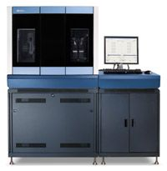
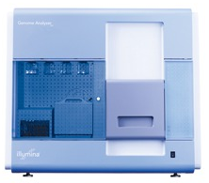
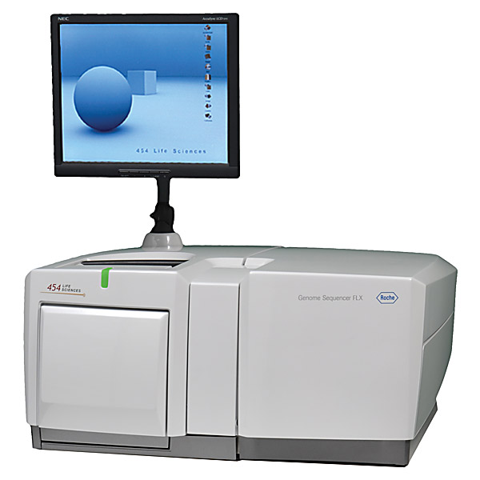
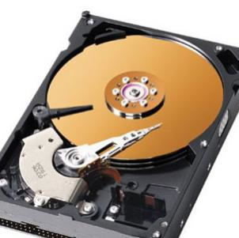

A typical NGS workflow
There might be
10’s, 100’s or
thousands of samples.
This needs a coordinated workflow:
Alignment is just one part
Sample/Platform
Sample
merge
NA34842
NA87465
Library
merge
BAM
BAM
BAM
Library
Freeze
BAM
BAM
BAM
……
BAM
BAM
BAM
Improvement
BAM
BAM
BAM
……
BAM
BAM
Alignment
(bwa, smalt, bowtie etc)
Fastq
Fastq
Fastq
……
Fastq
Fastq
Notes:
FIRST:
TYPICAL NGS EXPERMIENTS ARE DONE AT SCALE: there may be 100s => 10k’s of samples.
That needs a coordinated workflow, driven by planned software to bring it reliably together.
The alignment we were discussing is just the first part of that.

Slide 49
A typical NGS workflow
Typically in a production workflow:
One sample spread over multiple seq libraries.
One library spread over multiple seq runs (lanes)
Sample/Platform
Sample
merge
NA34842
NA87465
Library
merge
BAM
BAM
BAM
Library
Freeze
BAM
BAM
BAM
……
BAM
BAM
BAM
Improvement
BAM
BAM
BAM
……
BAM
BAM
Alignment
(bwa, smalt, bowtie etc)
Fastq
Fastq
Fastq
……
Fastq
Fastq
Notes:
Moreover, in that workflow,
A sequencing plan might:
Split a sample across multiple libraries – this happens sometimes
And split a library across multiple lanes - that happens A LOT.
WHY?

Slide 50
Data production workflow
Typically in a production workflow:
One sample spread over multiple seq libraries.
One library spread over multiple seq runs (lanes)
Sample/Platform
Sample
merge
NA34842
NA87465
Library
merge
BAM
BAM
BAM
Library
Freeze
BAM
BAM
BAM
……
BAM
BAM
BAM
Improvement
BAM
BAM
BAM
……
BAM
BAM
Alignment
(bwa, smalt, bowtie etc)
Fastq
Fastq
Fastq
……
Fastq
Fastq
WHY?

Slide 51
Data production workflow
Typically in a production workflow:
One sample spread over multiple seq libraries.
One library spread over multiple seq runs (lanes)
Sample/Platform
Sample
merge
NA34842
NA87465
Library
merge
BAM
BAM
BAM
Library
Freeze
BAM
BAM
BAM
……
BAM
BAM
BAM
Improvement
BAM
BAM
BAM
……
BAM
BAM
Alignment
(bwa, smalt, bowtie etc)
Fastq
Fastq
Fastq
……
Fastq
Fastq
Mitigation of batch (run/instrument) effects
Split library over multiple lanes
- Increasing sequencing depth (more libraries)
Notes:
The split of a library across multiple runs is to mitigate batch effects:
Say you have four samples:
If you process first sample in one run and your second sample in a second run etc, then you are open to
losing your second sample if your run fails
Having pronounced difference in read-depth if there’s a difference between runs, or any other systematic effect that your QC would flag up.
Split ALL of your samples across four runs (say) and the variability in one run is smeared across all your samples.
Secondly, you may have to increase the number of runs for a specific sample to increase the read-depth (seq volume),
SO you have to prepare multiple libraries.

Slide 52
Data production workflow
Typically in a production workflow:
One sample spread over multiple seq libraries.
One library spread over multiple seq runs (lanes)
Sample/Platform
Sample
merge
NA34842
NA87465
in previous talk
Library
merge
BAM
BAM
BAM
Library
Freeze
BAM
BAM
BAM
……
BAM
BAM
BAM
Improvement
POST-ALIGN QC
BAM
BAM
BAM
……
BAM
BAM
This step is the alignment of FASTQ
Alignment
(bwa, smalt, bowtie etc)
Fastq
Fastq
Fastq
……
Fastq
Fastq
Notes:
WE NOW POINT OUT A SECOND ASPECT of this workflow : ACCOMPANIED by three different additional software “treatments” of the alignments.
We’ve talked about how the alignment is DONE.
1) POST ALIGN QC. After that alignment, you have the perfect opportunity to to see if there were problems in the library or in the run itself.

Slide 53
Data production workflow
Typically in a production workflow:
One sample spread over multiple seq libraries.
One library spread over multiple seq runs (lanes)
Sample/Platform
Sample
merge
NA34842
NA87465
Library
merge
BAM
BAM
BAM
Library
Freeze
GATK BAM IMPROVEMENT
BAM
BAM
BAM
……
BAM
BAM
BAM
Improvement
POST-ALIGN QC
BAM
BAM
BAM
……
BAM
BAM
This step is the alignment of FASTQ
- We’ve discussed this at length
Alignment
(bwa, smalt, bowtie etc)
Fastq
Fastq
Fastq
……
Fastq
Fastq
Notes:
The next part, if you are happy with the sequencing of your library components, is to do what’s typically called BAM IMPROVEMENT
This is a pair of software processes introduced by GATK during the processing of thousand genome data: actually alter the bam files.

Slide 54
BAM improvement
FIRST - align each separate FASTQ: library x lane
Input: BAM
Process 1: INDEL (local) realignment
Process 2: Base quality recalibration
Output: BAM
Merge independent lanes BAMS in same library together
Process 3: library - level mark-duplication
BAM improvement Part of …
“GATK Best Practice”
Notes:
Base Quality Score Recalibration
The second is Mark Duplication
And I will describe and motivate them briefly.
IN OLD DOC you may come across indel realignment: don’t worry about that – it’s been superceded by the methods of the actual variant calling

Slide 55
BAM Improvement - Base Quality Score Recalibration
Each base call has an associated base call quality (find this in the fastq and sam record)
What is the chance that the base call is incorrect?
Illumina evidence: intensity values + cycle
Phred values (log scale)
Q10 = 1 in 10 chance of base call incorrect
Q20 = 1 in 100 chance of base call incorrect
Accurate base qualities essential measure in variant calling
Rule of thumb: Anything less than Q20 is not useful data
BUT:
The base quality scores produced by a sequencer can be influenced by systematic technical error:
They can vary with sequence context, position in read etc.
Therefore the quality score can be off
Therefore variant calling can be influenced.
BQSR: adjusts the quality of each base to adjust for these systematic errors
https://www.ncbi.nlm.nih.gov/pmc/articles/PMC3409179/

Slide 56
Base quality recalibration
The idea of recalibration:
Use the alignment of your reads to a human reference
Remove all known variants dbSNP+1000G etc SNP sites
Assume all other mismatches in your data are sequencing errors
Now you can infer the mean observed (“empirical”) error rate for these bins:
Position of base in read (1 => length of read)
Dinucleotide Sequence Context: AA, AT …, CA, CT …
Empirical quality = number of mismatches / total number in bin.
Compare empirical quality to reported sequencer base quality in each of these categories.
Derive an adjustment for each category, to be applied to each reported base quality value
e.g. Reported: Sequencer reports Q25 base calls for a “T” in context “AT"
Empirical: After alignment - it may be that ”T” in context “AT” actually mismatches the reference at a 1 in 100 rate, so are actually Q20
Adjustment: for every T in “AT” – subtract 5 from BQ. (30=>25, 21=> 16 etc)
NOTE: requires a reference genome and a catalog of variable sites

Slide 57
Base quality recalibration effects

Slide 58
Data production workflow
One sample
…spread over…
Multiple libraries
One library
…spread over…
Multiple runs (lanes)
Sample/Platform
Sample
merge
NA34842
NA87465
We squeeze in a library-level dedup right here.
Library
merge
BAM
BAM
BAM
Library
Freeze
GATK BAM IMPROVEMENT
BAM
BAM
BAM
……
BAM
BAM
BAM
Improvement
POST-ALIGN QC
BAM
BAM
BAM
……
BAM
BAM
This step is the alignment of FASTQ
- We’ve discussed this at length
Alignment
(bwa, smalt, bowtie etc)
Fastq
Fastq
Fastq
……
Fastq
Fastq
Notes:
WE’RE ALMOST DONE.
The last thing I wanted to mention is the de-duplication once you’ve merged to library.

Slide 59
Library duplicates
All second-gen sequencing platforms are NOT single molecule sequencing
PCR amplification step in library preparation
Can result in duplicate DNA fragments in the final library prep.
PCR-free protocols do exist – require larger volumes of input DNA
Problem: can result in false SNP calls
Duplicates manifest themselves as high read depth support
Solution:
Align reads to the reference genome
Identify read-pairs where the outer ends map to the same position on the genome and remove all but 1 copy
Samtools: samtools rmdup
Picard/GATK: MarkDuplicates
Generally low number of duplicates in good libraries (<5%). But I see ~15%
Notes:
This is where duplication comes from:
We should note that PCR amplification is a step in most library preparations.
Therefore, there WILL be duplicate reads in the system, which are not biological.
That’s a problem – it will artificially increase confidence in a variant call.
Once you’ve aligned, though, you can manage this:
Because the PCR dups will have their outer ends at the same genomic position.
So you can spot this and remove all but one read.
There is an expectiation that a typical library will have about 5% dups this way, but I see close to 15% often, so I think it’s library / chemistry dependent.

Slide 60
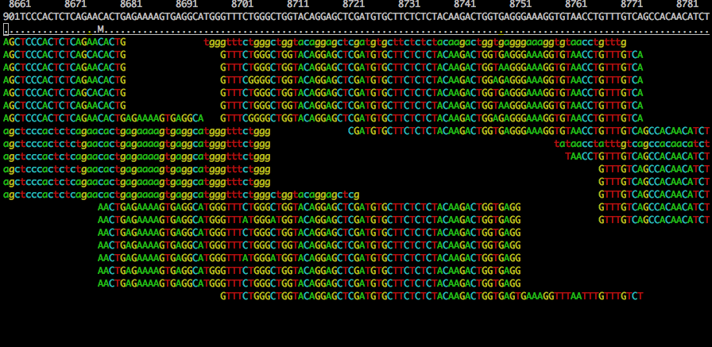
Duplicates and False SNPs

Slide 61
Duplicates and False SNPs

Slide 62
Data production workflow
One sample
…spread over…
Multiple libraries
One library
…spread over…
Multiple runs (lanes)
Sample/Platform
Sample
merge
NA34842
NA87465
We squeeze in a library-level dedup right here.
Library
merge
BAM
BAM
BAM
Library
Freeze
GATK BAM IMPROVEMENT
BAM
BAM
BAM
……
BAM
BAM
BAM
Improvement
POST-ALIGN QC
BAM
BAM
BAM
……
BAM
BAM
This step is the alignment of FASTQ
- We’ve discussed this at length
Alignment
(bwa, smalt, bowtie etc)
Fastq
Fastq
Fastq
……
Fastq
Fastq
Notes:
This last slide is just a reminder that alignment is just one part of the process that gets you from fastq to sample-level BAM, which you can run analysis on.

Slide 63
Overview
If you are an consumer then you should have a grasp of this
Intro
Methods / Aligners
After alignment: BAM file improvement before variant calling
An informatics group should have control of this, but you should be aware that it’s being done.

Slide 64
QUESTIONS?

Slide 65
Mapping qualities
The parable of the sequencer change evaluation
July 2023
Sanger wants to change sequencers from Novaseq 6000 to Novaseq X
We have to evaluate whether this is “OK”
Sequence identical samples with both technologies and ask research groups to compare old and new results
Notes:
Here’s an example of a region where the MAPQ of the reads abruptly goes to zero over a LINE1 element

Slide 66
Mapping qualities
The parable of the sequencer change evaluation
July 2023
Sanger wants to change sequencers from Novaseq 6000 to Novaseq X
We have to evaluate whether this is “OK”
Sequence identical samples with both technologies and ask research groups to compare old and new results
Critical : we do a good comparison, otherwise we could either introduce artefact (fake signal) or miss real signal
Notes:
Here’s an example of a region where the MAPQ of the reads abruptly goes to zero over a LINE1 element

Slide 67
Mapping qualities
The parable of the sequencer change evaluation
Samples:
5 WGS samples (“Genome in a bottle”, “Coriell”), depth about 40x
Including “NA12878”
Samples are very well characterised – known “true positives”
Sequenced both with Novaseq 6000 and Novaseq X
Notes:
Here’s an example of a region where the MAPQ of the reads abruptly goes to zero over a LINE1 element

Slide 68
Mapping qualities
The parable of the sequencer change evaluation
Samples:
5 WGS samples (“Genome in a bottle”, “Coriell”), depth about 40x
Including “NA12878”
Samples are very well characterised – known “true positives”
Sequenced both with Novaseq 6000 and Novaseq X
Analysis : August 2023
Align using bwa-mem2
WGS variant call
Evaluate whether we are missing true positives, adding false negatives
Notes:
Here’s an example of a region where the MAPQ of the reads abruptly goes to zero over a LINE1 element

Slide 69
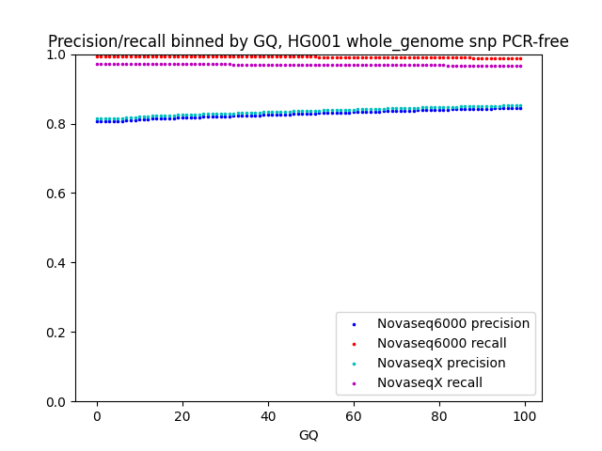
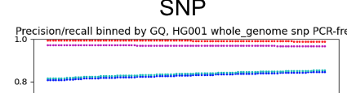
Mapping qualities
The parable of the sequencer change evaluation
New tech shows DROP of about 3% in recovery of TRUE POSITIVES. Yikes!
Notes:
Here’s an example of a region where the MAPQ of the reads abruptly goes to zero over a LINE1 element

Slide 70
Mapping qualities
The parable of the sequencer change evaluation
20000 variants in TRUTH SET
OLD TECH: saw 98% of them
NEW TECH: sees 93% of them
How would you investigate ?
TRUTH SET : 20k variants
OLD – 98%
New – 93%
Notes:
Here’s an example of a region where the MAPQ of the reads abruptly goes to zero over a LINE1 element

Slide 71
Mapping qualities
The parable of the sequencer change evaluation
20000 variants in TRUTH SET
OLD TECH: saw 98% of them
NEW TECH: sees 93% of them
How would you investigate ?
TRUTH SET : 20k variants
OLD – 98% recovered
New – 93%
EYEBALL “pileups” in IGV of variants in the “missed” set
OLD set minus NEW set
Are the depths wonky ? MAPQ off ?
Other artefact ?
Notes:
Here’s an example of a region where the MAPQ of the reads abruptly goes to zero over a LINE1 element

Slide 72
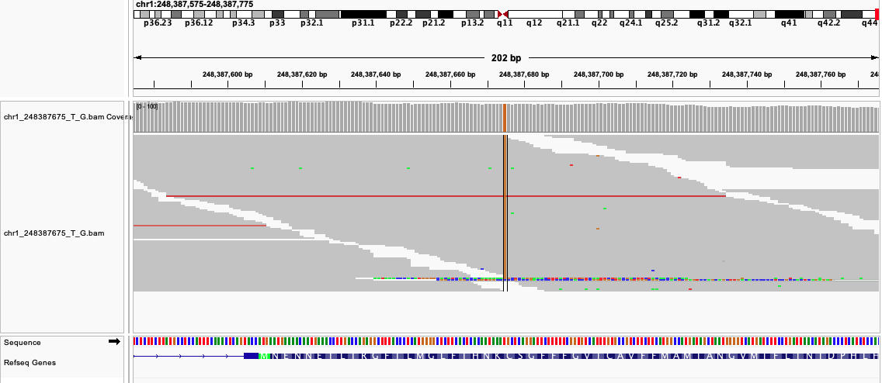
Mapping qualities
The parable of the sequencer change evaluation
TRUTH SET : 20k variants
OLD – 98% recovered
New – 93%
OLD
Notes:
Here’s an example of a region where the MAPQ of the reads abruptly goes to zero over a LINE1 element

Slide 73
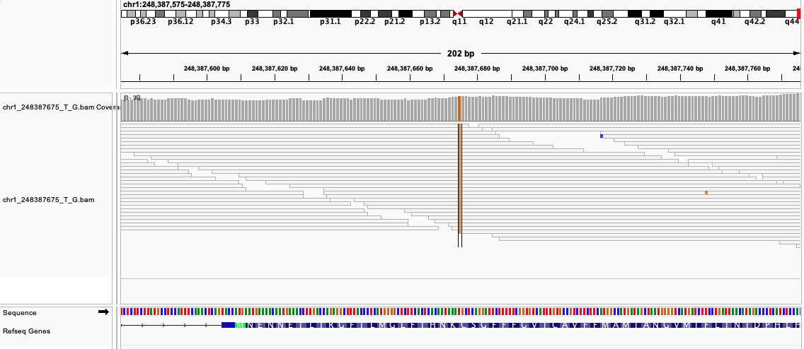
Mapping qualities
The parable of the sequencer change evaluation
TRUTH SET : 20k variants
OLD – 98% recovered
New – 93%
NEW
Notes:
Here’s an example of a region where the MAPQ of the reads abruptly goes to zero over a LINE1 element

Slide 74
TRUTH SET : 20k variants
OLD – 98% recovered
New – 93%
OLD
MAPQ ~60
variant called
NEW
MAPQ = 0
variant is ignored!
Let’s have a look at these reads!

Slide 75
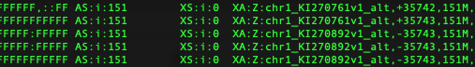
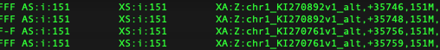
Old sequences
Read name
location
MAPQ
CIGAR
Suboptimal alignment score
Other alignment
chr1_KI270761v1_alt
Perfect hit
New sequences

Slide 76
Old sequences
Read name
location
MAPQ
CIGAR
Suboptimal alignment score
Other alignment
chr1_KI270761v1_alt
Perfect hit
New sequences
Both old and new sequences have alt alignment to something called “chr1_KI270892v1_alt”
Old: MAPQ 60, XS 0
New: MAPQ of primary alignment went to 0 , XS 151

Slide 77
Old sequences
Read name
location
MAPQ
CIGAR
Suboptimal alignment score
Other alignment
chr1_KI270761v1_alt
Perfect hit
New sequences
WHY ??
Both old and new sequences have alt alignment to something called “chr1_KI270892v1_alt”
Old: MAPQ 60, XS 0
New: MAPQ of primary alignment went to 0 , XS 151

Slide 78
Old sequences
Read name
location
MAPQ
CIGAR
Suboptimal alignment score
Other alignment
chr1_KI270761v1_alt
Perfect hit
New sequences
Both chr1 and “chr1_KI270892v1_alt” are in GRCh38.fa
Reads align identically to both
Identical alignment in 2 places => MAPQ = 0
Suboptimal alignment score = 151
Both old and new sequences have alt alignment to something called “chr1_KI270892v1_alt”
Old: MAPQ 60, XS 0
New: MAPQ of primary alignment went to 0 , XS 151

Slide 79
Old sequences
Read name
location
MAPQ
CIGAR
Suboptimal alignment score
Other alignment
chr1_KI270761v1_alt
Perfect hit
New sequences
Why didn’t that happen in the old sequences ??
SAME ASSEMBLY
BUT MAPQ = 60
Suboptimal alignment score = 0
Both old and new sequences have alt alignment to something called “chr1_KI270892v1_alt”
Old: MAPQ 60, XS 0
New: MAPQ of primary alignment went to 0 , XS 151

Slide 80
Old sequences
Read name
location
MAPQ
CIGAR
Suboptimal alignment score
Other alignment
chr1_KI270761v1_alt
Perfect hit
New sequences
Why didn’t that happen in the old sequences ??
SAME ASSEMBLY
BUT MAPQ = 60
Suboptimal alignment score = 0
BECAUSE YOU CAN TELL BWA-MEM2 to ignore alt sequences when doing the mapping!
Both old and new sequences have alt alignment to something called “chr1_KI270892v1_alt”
Old: MAPQ 60, XS 0
New: MAPQ of primary alignment went to 0 , XS 151

Slide 81
Old sequences
Read name
location
MAPQ
CIGAR
Suboptimal alignment score
Other alignment
chr1_KI270761v1_alt
Perfect hit
New sequences
Why didn’t that happen in the old sequences ??
SAME ASSEMBLY
BUT MAPQ = 60
Suboptimal alignment score = 0
BECAUSE YOU CAN TELL BWA-MEM2 to ignore alt sequences when doing the mapping!
And they didn’t when they gave us the new alignments!
Both old and new sequences have alt alignment to something called “chr1_KI270892v1_alt”
Old: MAPQ 60, XS 0
New: MAPQ of primary alignment went to 0 , XS 151

Slide 82
Old sequences
Read name
location
MAPQ
CIGAR
Suboptimal alignment score
Other alignment
chr1_KI270761v1_alt
Perfect hit
New sequences
Why didn’t that happen in the old sequences ??
SAME ASSEMBLY
BUT MAPQ = 60
Suboptimal alignment score = 0
BECAUSE YOU CAN TELL BWA-MEM2 to ignore alt sequences when doing the mapping!
And they didn’t when they gave us the new alignments!
DOH!
Both old and new sequences have alt alignment to something called “chr1_KI270892v1_alt”
Old: MAPQ 60, XS 0
New: MAPQ of primary alignment went to 0 , XS 151

Slide 83
INTERLUDE – PAIRED END SEQUENCING PARAMETERS
Notes:
The effect of compression on a SAM (not compressed) using BAM, lossless CRAM and lossy CRAM.
Format of the future. Many NGS pipelines now adopting CRAM for long term storage (less storage required).
CRAM lossless is better now than shown here

Slide 84
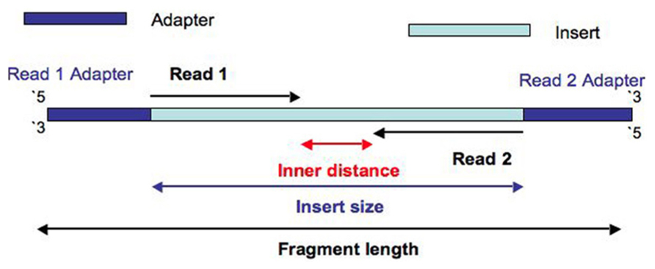
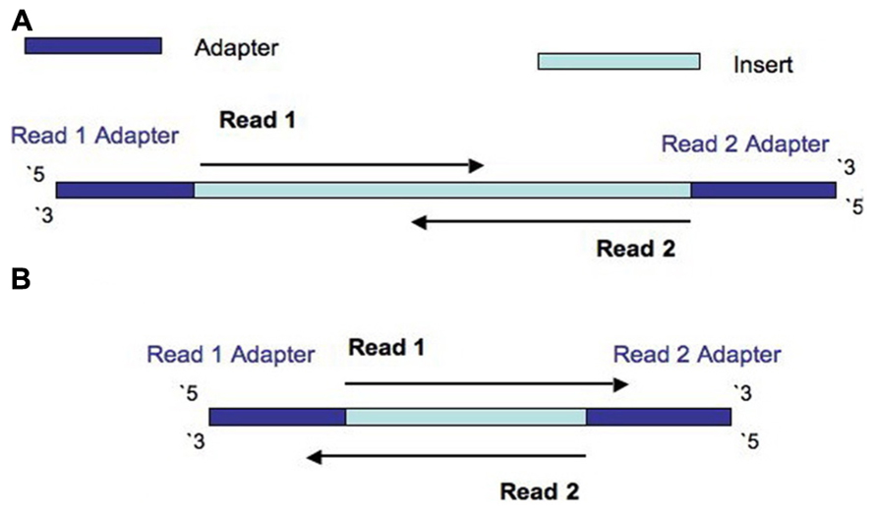
Fragment length, insert size and inner mate distance
Insert size > length(read 1 + read 2)
Insert size < length(read 1 + read 2)
Insert size < length(read 1); Insert size < length(read 2)
Turner, 2014. PMID:24523726
Notes:
Much of WGS and WES is paired-end sequencing, meaning that
the genome is sheared into fragments,
sequencing adapters added to the end of each fragment,
And then TWO sequencing reads are created, reading in from the adaptors.
That straight away gives you these parameters that you can read off once the alignment is done:
Insert size
Inner distance
Note – I’ve put up three possible situations that could occur, depending on how large the fragment is compared to the read length:
ALL is well, and the insert size is larger than combined read-length
The reads overlap because the insert size is too small. This is bad. Why?
Reads actually overrun the insert and read into the opposite sequencing adaptor.
I am pointing this out because shortly we will be viewing read pairs! We will probably not see overlapping reads, BUT we will be seeing unexpectedly large inserts, in the context of large deletions.

Slide 85
Fragment length, insert size and inner mate distance
Insert size > length(read 1 + read 2)
Both reads get the same “name”
Insert size < length(read 1 + read 2)
Insert size < length(read 1); Insert size < length(read 2)
Turner, 2014. PMID:24523726
Notes:
Much of WGS and WES is paired-end sequencing, meaning that
the genome is sheared into fragments,
sequencing adapters added to the end of each fragment,
And then TWO sequencing reads are created, reading in from the adaptors.
That straight away gives you these parameters that you can read off once the alignment is done:
Insert size
Inner distance
Note – I’ve put up three possible situations that could occur, depending on how large the fragment is compared to the read length:
ALL is well, and the insert size is larger than combined read-length
The reads overlap because the insert size is too small. This is bad. Why?
Reads actually overrun the insert and read into the opposite sequencing adaptor.
I am pointing this out because shortly we will be viewing read pairs! We will probably not see overlapping reads, BUT we will be seeing unexpectedly large inserts, in the context of large deletions.

